Slide 1

Orientation Session
CHHD Program
Fall 2024
By Sara Beydoun

Slide 2


CHHD: Child Health and Human Development
Fields of study:
  Fertility, conception, and reproduction
  Birth and development
  Pediatric diseases and progression
Four research themes:
  Human Reproduction & Development
  Molecular & Cellular Determinants of Child Health
  Neuroscience
  Health Outcomes in Childhood Diseases

Slide 3
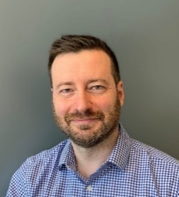
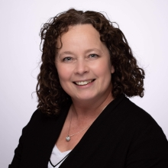
The Leadership Team
Dr. Kolja Eppert, PhD
Program Leader
Email: kolja.eppert@mcgill.ca
Tel: (514) 934-1934 ext. 23876
Dr. Isabelle Gagnon, PhD
Associate Program Leader
Email: isabelle.gagnon8@mcgill.ca
Tel: 514-412-4400 ext. 23896

Slide 4

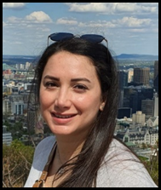
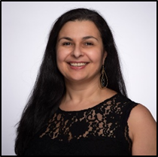

The Admin Team
Murielle M. Akpa, PhD
Interim Program Manager
Email: murielle.akpa@muhc.mcgill.ca
Tel: 514-934-1934 ext. 76360
Office: EM0.3211
Sara Beydoun, MBA
Technical Coordinator
Email: sara.beydoun@muhc.mcgill.ca
Tel: (514) 934-1934 ext. 76128
Office: EM0.3211
Angela Roussos
Program Assistant
Email: angela.roussos@muhc.mcgill.ca
Tel: (514) 934-1934 ext. 23023
Office: EM0.3221
Rosanna Camarda
Program Assistant
Email: rosanna.camarda@muhc.mcgill.ca
Tel: (514)934-1934 ext. 22418
Office: EM0.3217

Slide 5

Check out our renewed website! https://www.chhd-program.com
To access links for the TeamUp calendars to book equipment and desks you should go to “Technical Resources” under the “Resources” page and login
      Password: youth2020

Slide 6
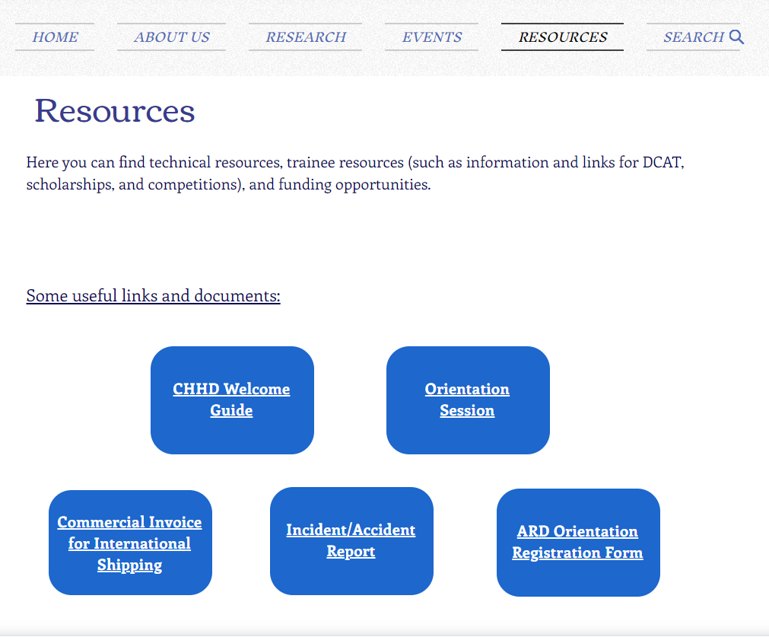
Useful Links and Documents

Slide 7
Training
All CHHD members should login to the RI-Portal and complete the applicable trainings.
Safety Training:
  Introduction to Emergency Measures
  Workplace Hazardous Materials Information System (WHMIS) for Laboratories
  Hazardous Waste Disposal
  Biosafety Principles
Animal Resources Division Training:
  Online Theory Course
  Specific Workshop

Slide 8



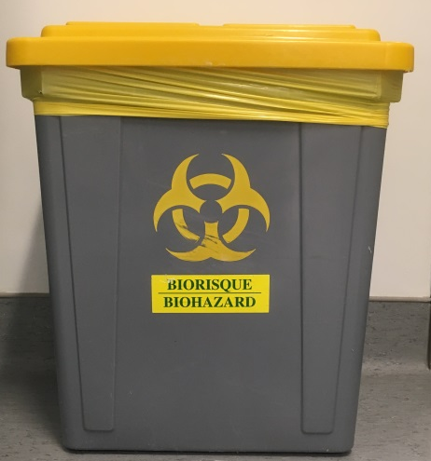






Waste Disposal
Biohazard
Contaminated
Not
Contaminated
"NON-
CONTAMINATED BROKEN GLASS"
"AGAROSE/
ACRYLAMIDE GELS"
"NON-CONTAMINATED PLASTICS"
Compatible with autoclave
SOLUTIONS

Slide 11
Recycling

Slide 13
Trainee Committee
The goal of the Trainee Committee is to plan events for CHHD trainees and assist with the organization of various CHHD events.
​

Slide 14


Follow us on Social Media!
Facebook
Child Health & Human Development Program (CHHDPROGRAM)
https://www.facebook.com/CHHDPROGRAM/
Instagram
@chhd.sedh
https://www.instagram.com/chhd.sedh/

Slide 15

Welcome aboard!
Thank you.

